Slide 1
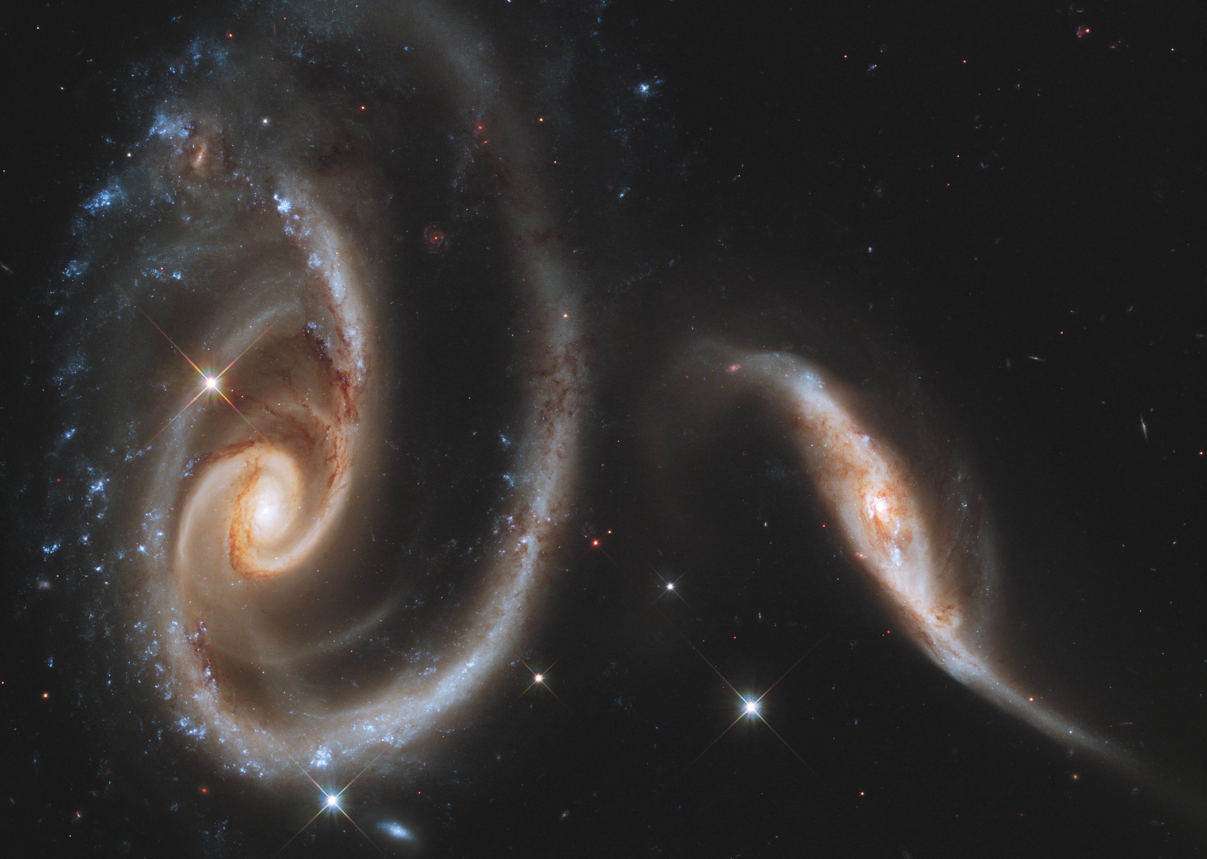
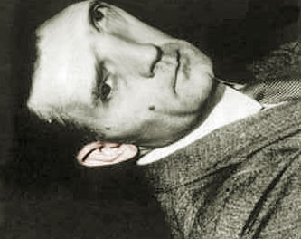
JAK DNES ZNÍ HUBBLOVA LADIČKA?
Hvězdárna Zlín 2018
Z internetu vykradl a sestavil Ivan Havlíček

Slide 2
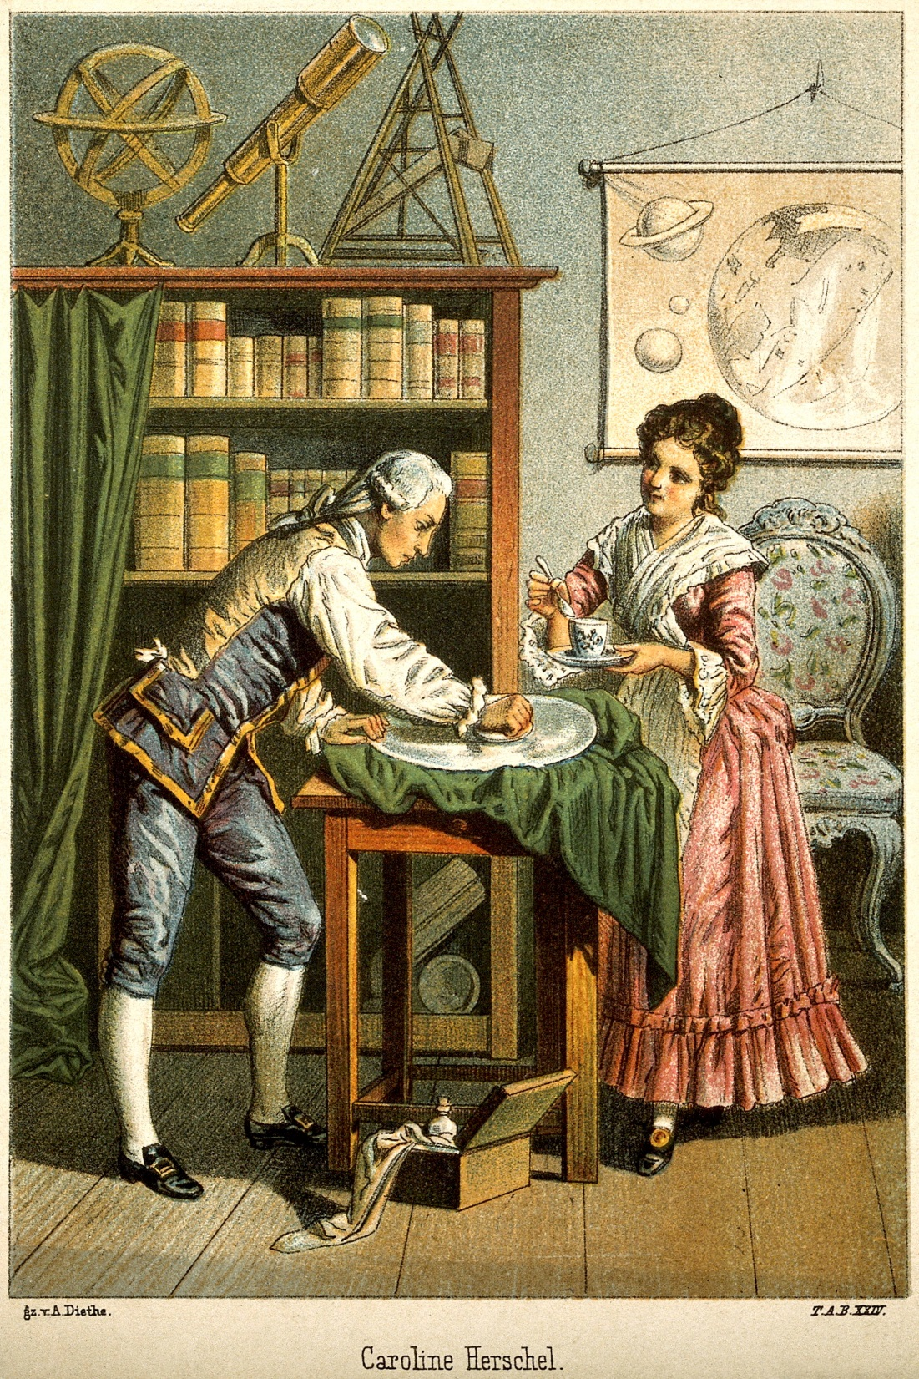
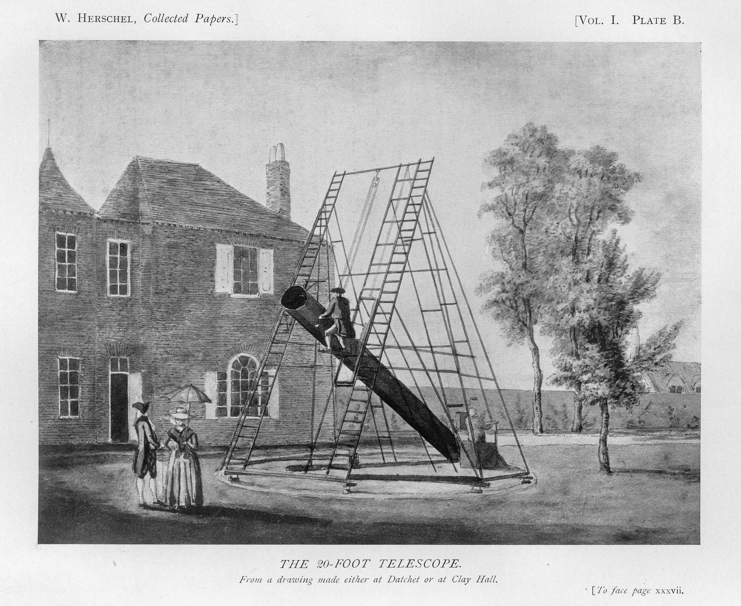
Jako historicky prvá klasifikace mlhovin bývá uváděna klasifikace Williama Herschela z roku 1786, kdy vydal svůj „Catalogue of One Thousand New Nebulae and Clusters of Stars“. Herschel zde navrhuje osm tříd pro jednotlivé astrofyzikální objekty:
1. Jasné mlhoviny [93 příkladů]
2. Slabé mlhoviny [402]
3. Velmi slabé mlhoviny [376]
4. Planetární mlhoviny [29]
5. Velmi velké mlhoviny [24]
6. Velmi hustá a bohatá uskupení hvězd [19]
7. Hodně zhuštěné skupiny velkých či malých hvězd [17]
8. Neuspořádaně roztroušené skupinky hvězd [40]

Slide 3
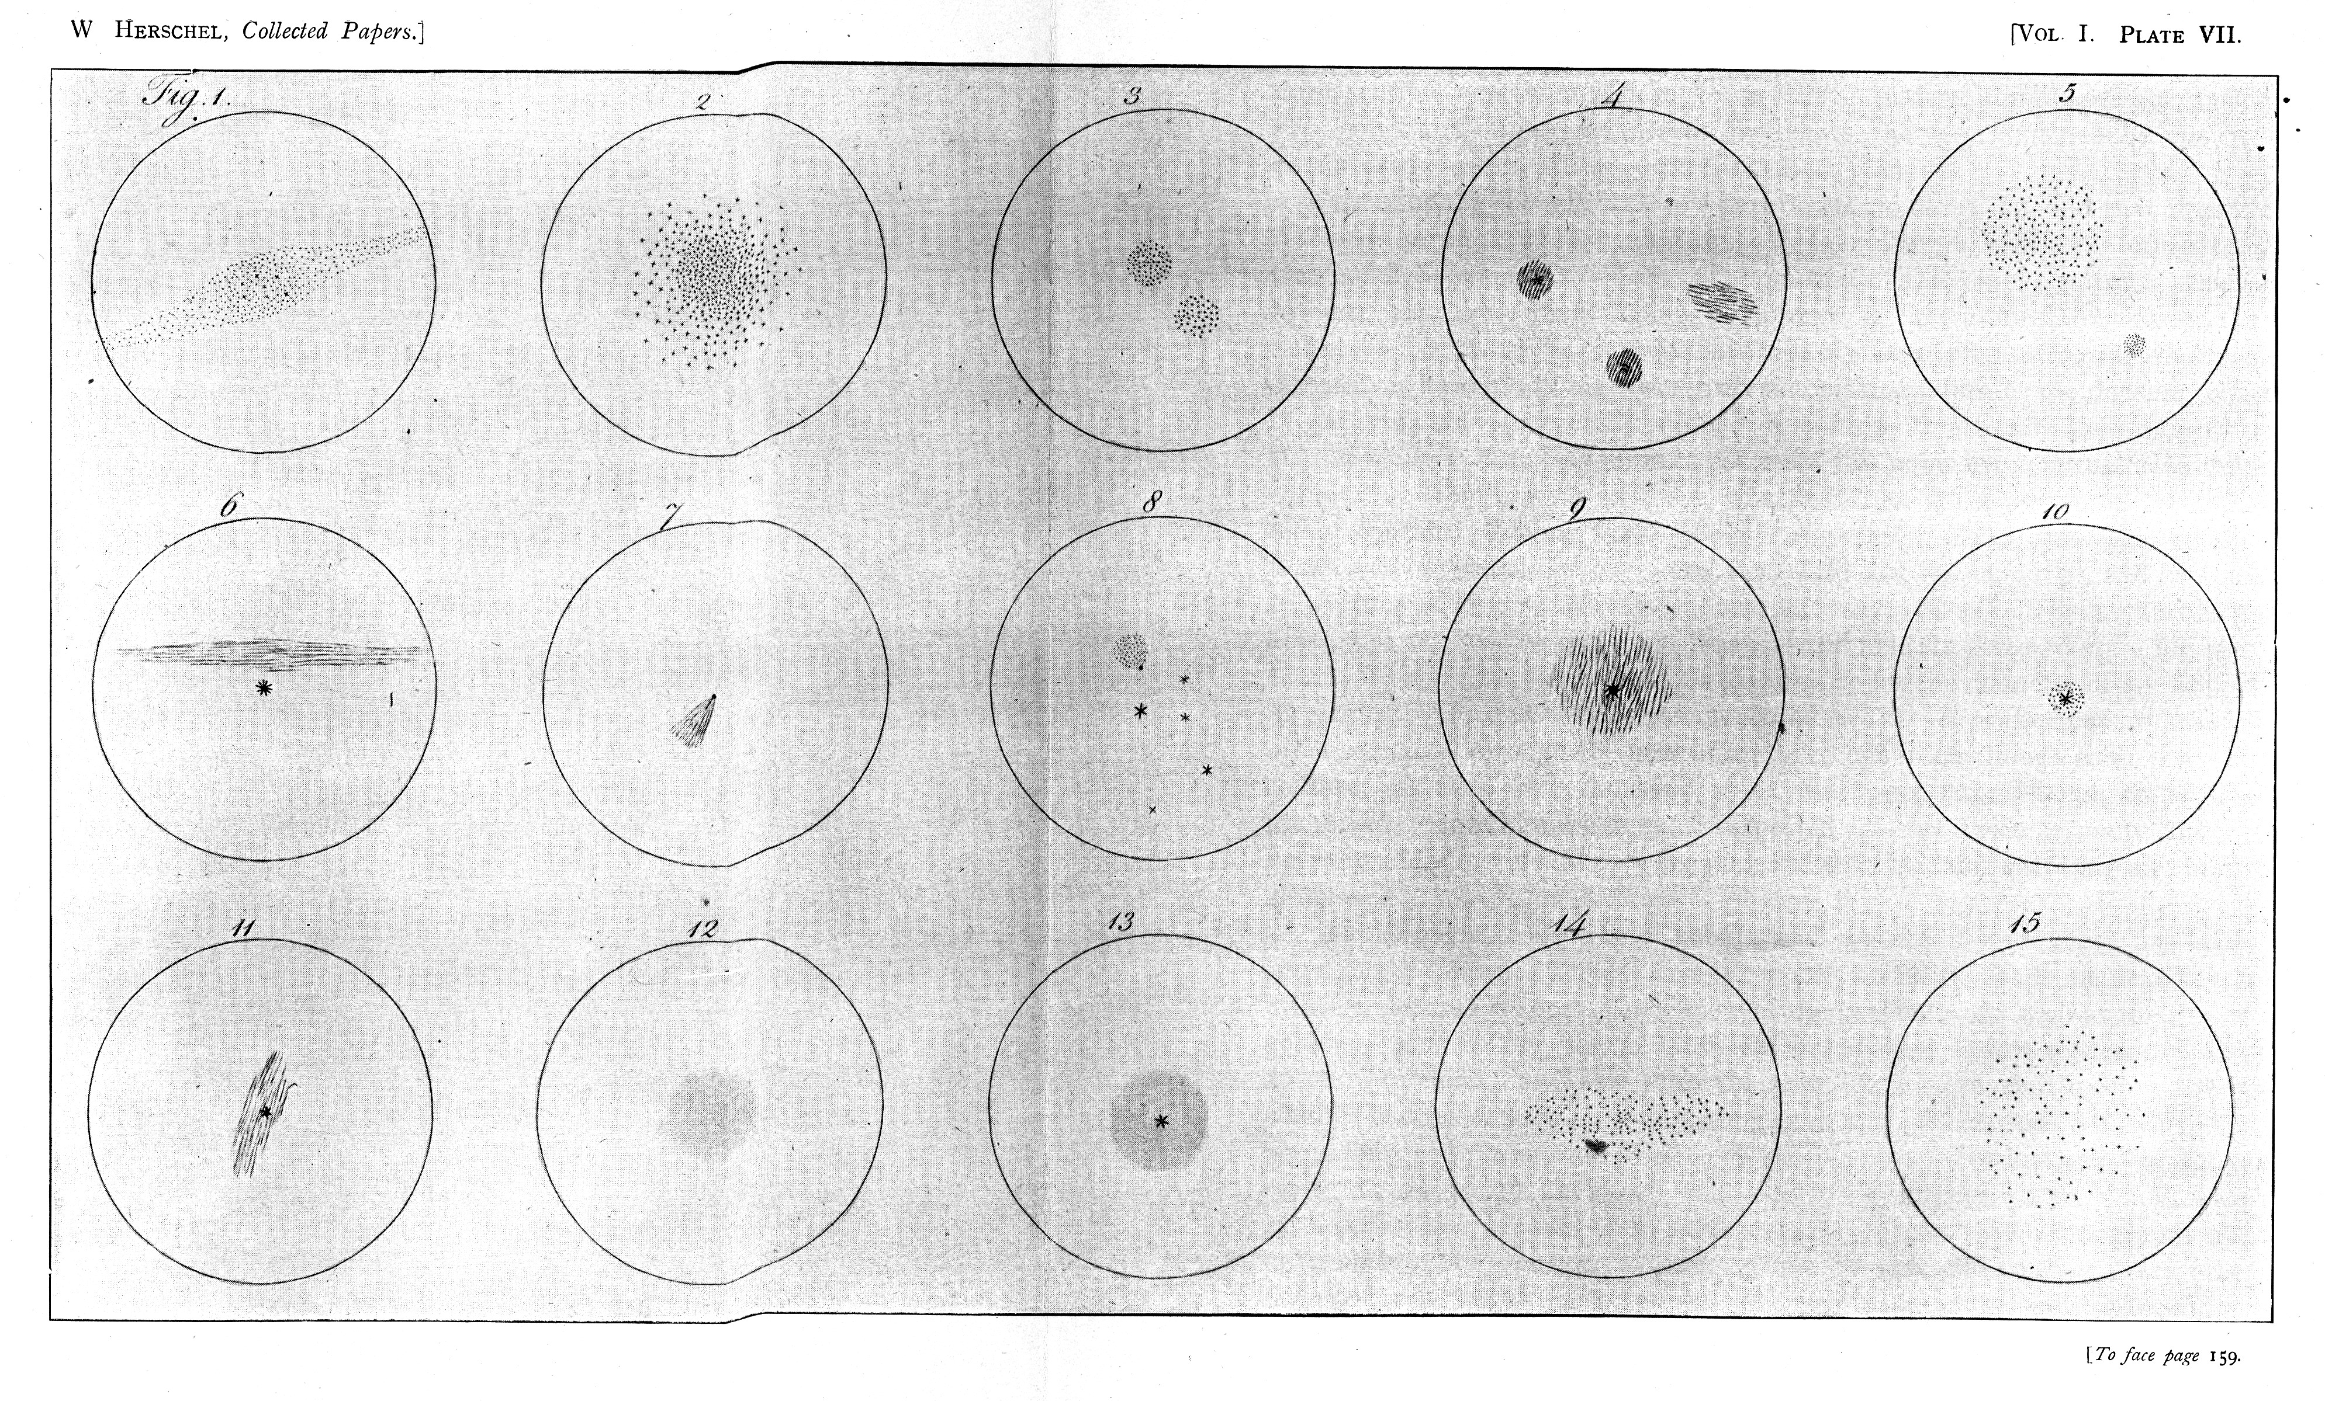
Herschel's Nebulae: Herschel's drawings of some observed nebulae from The Scientific Papers of Sir William Herschel published in London in 1912 by the Royal Society and the Royal Astronomy Society. It is interesting to recall that Herschel did not know the nature of these objects; that is what he was trying to determine. Notice, for instance, that there are bright black points next to some of the fuzzy objects. The fuzzy objects are millions of light years away, but the off-center black points are in our Galaxy (less than 0.3 million light years away). In 1754, Emmanuel Kant suggested that this was the case, but it was not proven until 1927.
Credit: The University of Chicago Library http://ecuip.lib.uchicago.edu/multiwavelength-astronomy/optical/history/05.html

Slide 4
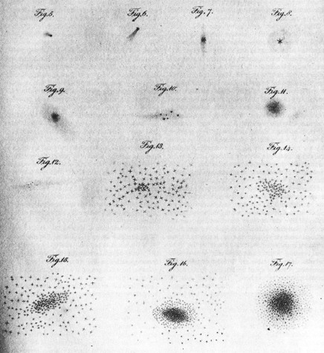
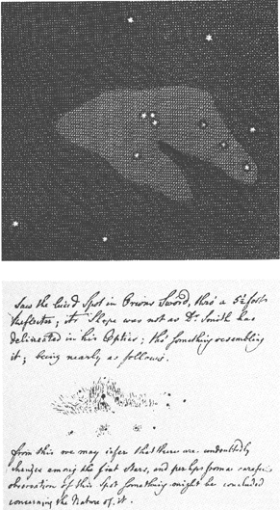
Dumbbell Nebula (M27) (left) and two alternative explanations of its appearance (right) were drawn by Herschel in his journal in 1784. He hypothesized that a huge, distant, comet-shaped star cluster (A) would look much like the Dumbbell Nebula to an observer is in front of it: the nearest stars would be seen individually, those farther away would be seen as "resolvable" nebulosity and those farthest away would be seen as "milky" nebulosity. Herschel had previously believed that the milky nebulosity was a luminous fluid quite unlike stars; M27 convinced him that this kind of nebulosity was merely the result of distance.
CERTAIN STARS, NEBULAS AND CLUSTERS were selected by Herschel from among the thousands he had catalogued to illustrate different stages in his theory of stellar evolution. The drawings shown here accompanied a paper by Herschel read to the Royal Society in 1814. The paper presents his theory that individual stars arise out of congealing accumulations of nebulosity and "grow" by absorbing any nebulosity that is drawn to them. The stars thus formed are then gathered into clusters by the mutually attractive force of gravity. The final stage is represented by a dense globular cluster (bottom right), which collapses into itself.
ORION NEBULA (M42) was depicted in Robert Smith's A Complete System of Optics (top) and was drawn by Herschel (bottom) on March 4,1774, in his observing journal. Herschel was observant enough to note right away that "its Shape was not as D. Smith has delineated in his Optics." In the course of further examination over several years Herschel thought he detected changes in the nebula's shape. He reasoned that the Orion nebula, unlike others he observed, could not be an extremely distant cluster of stars but must instead be composed of "nebulosity," or luminous fluid. http://btc.montana.edu/ceres/malcolm/cd/universe/html/body_herschel.html

Slide 5
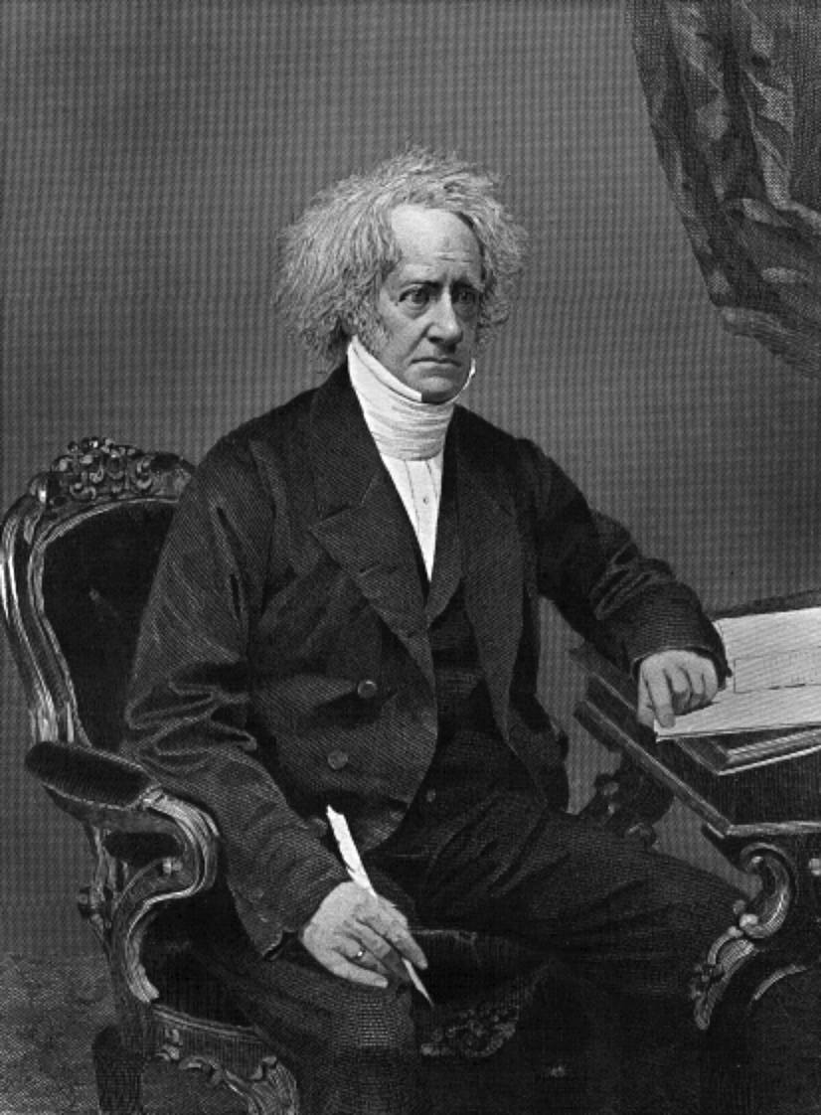
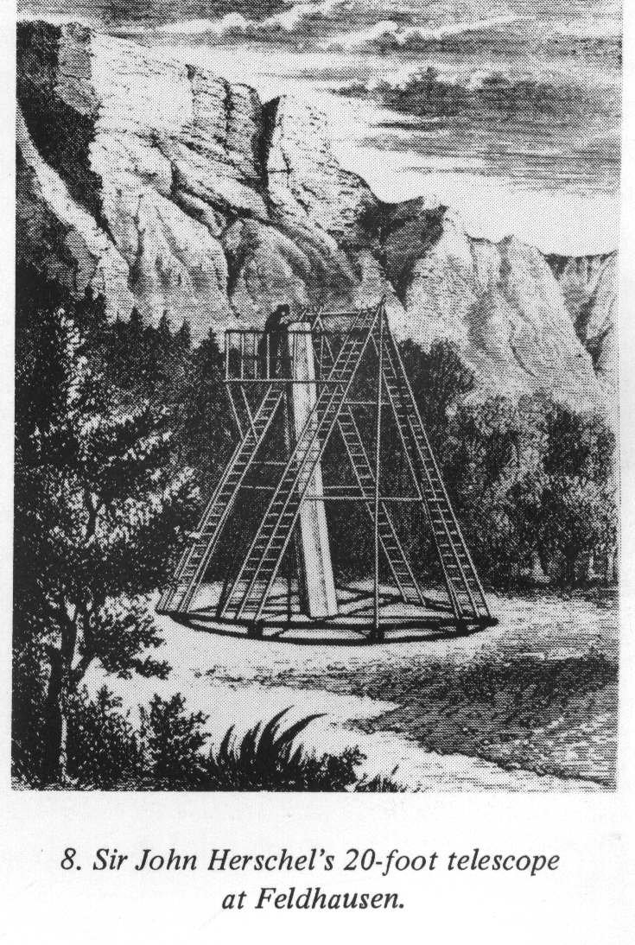
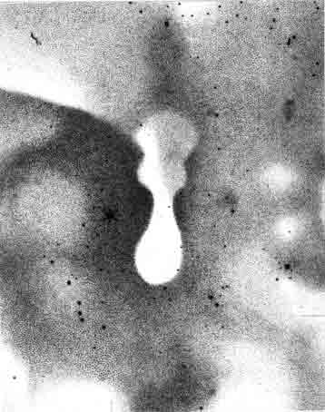
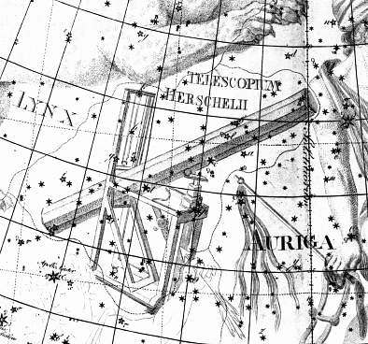
Velká mlhovina v Orionu na tisku Johna Herschela vytvořená 18 palcovým dalekohledem v Cape Town ve 30. letech 19. století.
Eta Carinae
The General Catalogue of Nebulae and Clusters byl vydán v r.1864 Johnem Herschelem. Spolu s dalšími pozorováními se později stal základem pro the New General Catalogue vydaný v 80. letech J. L. E. Dreyerem. The GC catalogued nebulae, obsahoval 5,000 objektů, z nichž polovinu napozoroval William Herschel a druhou polovinu John Herschel. Později byla tato práce doplněna a vydána po Johnově smrti pod názvem the General Catalogue of 10,300 Multiple and Double Stars.

Slide 6
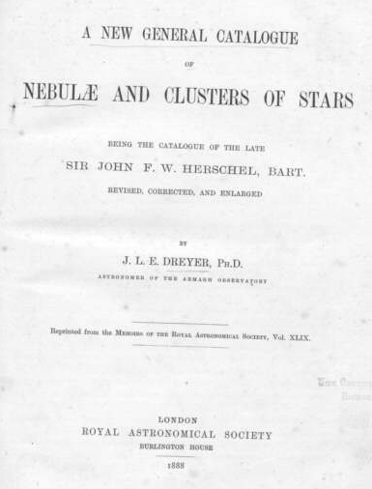
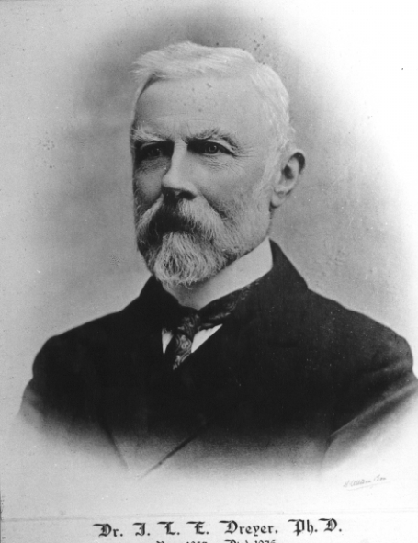
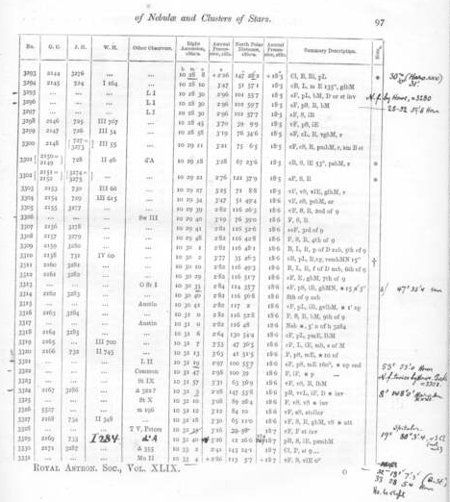
The New General Catalogue (NGC) is the best-known catalogue of deep sky objects in amateur astronomy. It contains nearly 8,000 objects, known as the NGC objects. The NGC is one of the largest comprehensive catalogues, as it includes all types of deep sky objects (not specialised to just galaxies for instance).
The catalogue was compiled in the 1880s by J. L. E. Dreyer using observations mostly from William Herschel, and then subsequently expanded with two Index Catalogues (IC I & IC II), adding nearly 5,000 objects.
Objects in the southern hemisphere sky are somewhat less thoroughly catalogued, but many were observed by John Herschel. The NGC contained many errors which have for the most part been eliminated by The NGC/IC Project www.ngcic.org.
The NGC was published in the Memoirs of the Royal Astronomical Society as A New General Catalogue of Nebulae and Clusters of Stars, being the Catalogue of the late Sir John F.W. Herschel, Bart., revised, corrected, and enlarged. (Dreyer J. L. E., 1888, Mem. R. Astron. Soc.
The Index Catalogue (IC) —also known as the Index Catalogue of Nebulae, the Index Catalogue of Nebulae and Clusters of Stars, IC I, or IC II— is a catalogue of galaxies, nebulae and star clusters that serves as a supplement to the New General Catalogue. It was first published in 1895, and has been expanded to list more than 5,000 objects, known as the IC objects.
The catalogue was compiled by J. L. E. Dreyer in the 1880s, who published it as two appendices (IC I & IC II) to the New General Catalogue. It summarized the discoveries of galaxies, clusters and nebulae between 1888 and 1907

Slide 7
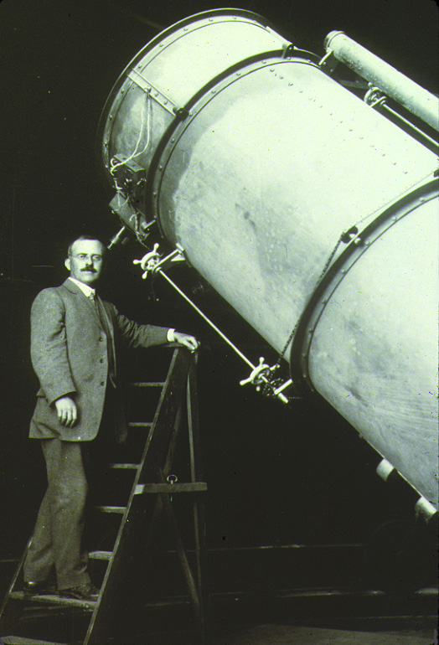
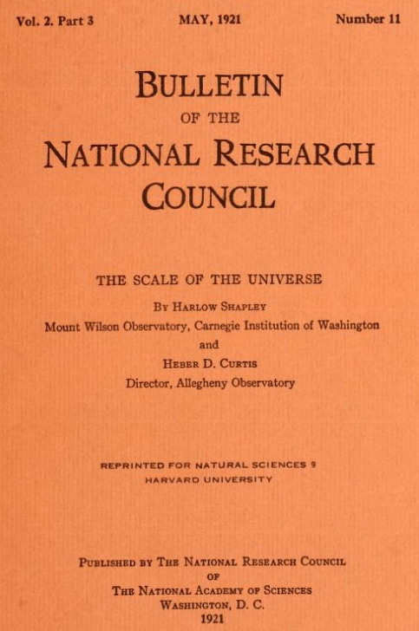
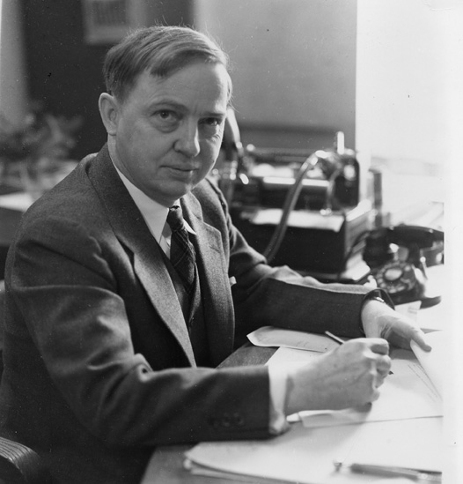
Velká debata 1920
26 April 1920,
in the Baird auditorium
of the Smithsonian Museum
of Natural History.
Harlow Shapley
Heber Doust Curtis
http://clownfish.rice.edu/astr201/open/papers/Shapley_Curtis_debate.pdf
https://archive.org/details/scaleofuniverse00shap

Slide 8
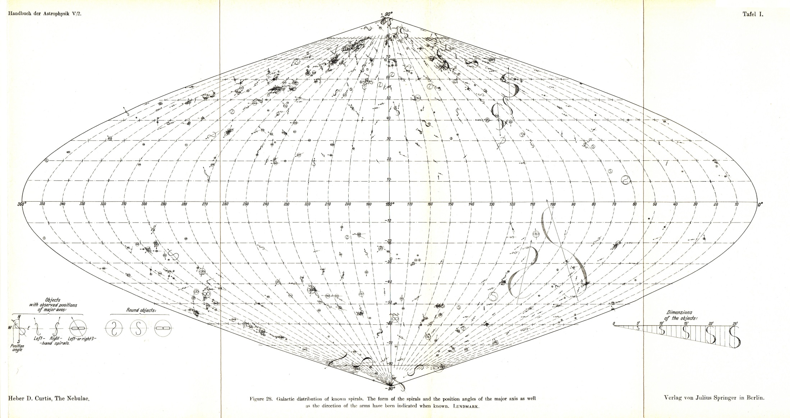
Rozmístění spirálních mlhovin na obloze v galaktických souřadnicích. Z mapy je zřejmé, že v rovině Mléčné dráhy chybějí spirální mlhoviny. Je to způsobeno tím, že jde o extragalaktické objekty a výhled na ně je zakryt blízkou látkou naší Galaxie.
Mapa je převzata z Curtisovy publikace „The Nebulae, Handbuch der Astrophysic“,
Vol. V/2, strany 774-936; Vol. VII Berlin: Springer 1933.

Slide 9
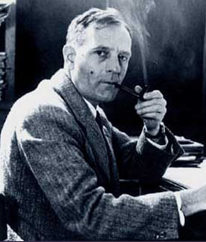
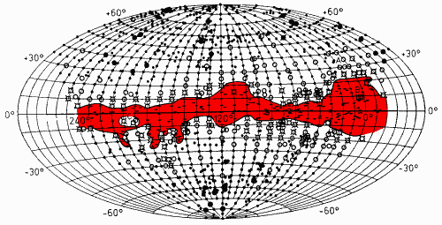
MLHOVINY: GALAKTICKÉ
EXTRAGALAKTICKÉ: NEPRAVIDELNÉ
PRAVIDELNÉ: ELIPTICKÉ
SPIRÁLNÍ
SPIRÁLNÍ S PŘÍČKOU
Edwin Powell Hubble (1889-1953)
Viditelnost extragalaktických mlhovin v galaktických souřadnicích (1934):
malé body – normální hustota,
velké body – výrazná hustota,
kroužky – úbytek galaxií,
sluníčka – výrazný úbytek,
červené pole – extragalaktické mlhoviny chybějí

Slide 10
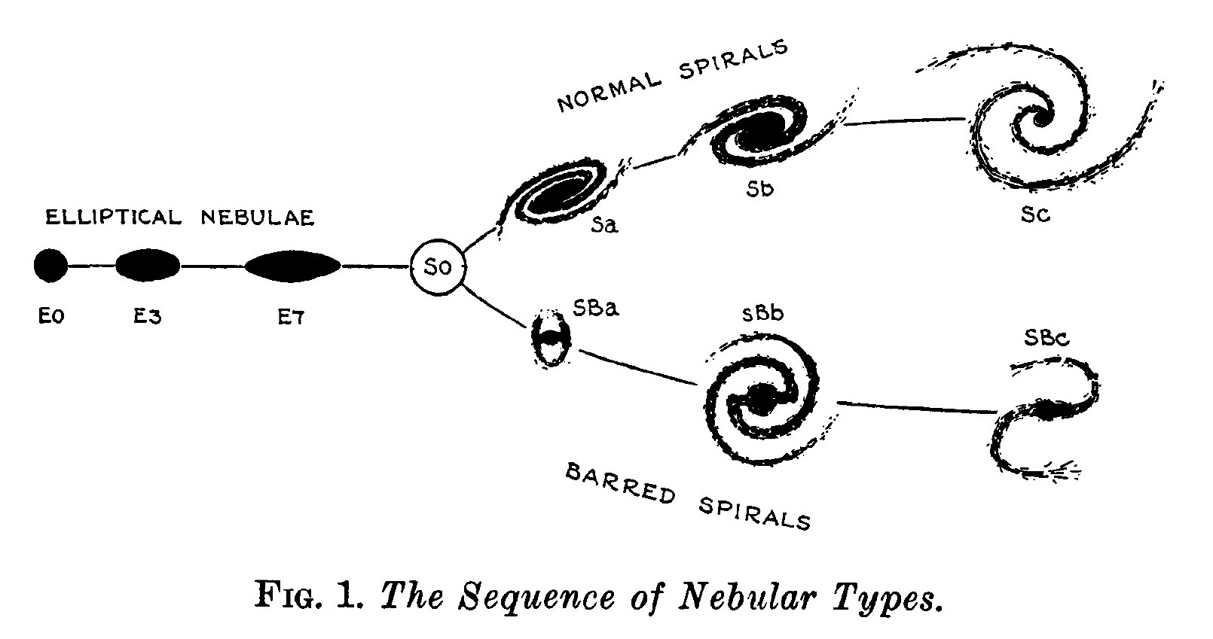
Hubblova ladička
Hubble rozdělil extragalaktické mlhoviny do tří větví, které se od přechodového typu S0 vyvíjely do postupně velmi odlišných tvarů. Jedna větev byla vyhrazena pro eliptické útvary, jejichž protáhlost – elipticita – byla založena na poměru největšího a nejmenšího průměru. Elipticitu Hubble definoval jako poměr (a−b)/a, kde a je největší a b nejmenší průměr soustavy. Typ E7 měl být čočkovitý útvar při pohledu z boku. Směrem od typu E7 protažení klesá až ke kruhovému typu E0. Spirální mlhoviny se směrem od typu S0 postupně rozvíjely a vzdálenost mezi konci jednotlivých ramen se zvětšovala. Sám Hubble k diagramu ale ještě v roce 1936 píše, že typ S0 je víceméně hypotetický přechodový útvar, přechod mezi E7 a SBa je hladký a plynulý, ale mezi E7 a Sa nebyly nalezeny mlhoviny žádné. Prvý nástin rozřazení galaxií Hubble navrhl již v roce 1922.
Zdroj: Edwin Hubble: The Realm of the Nebulae, str. 45.

Slide 11
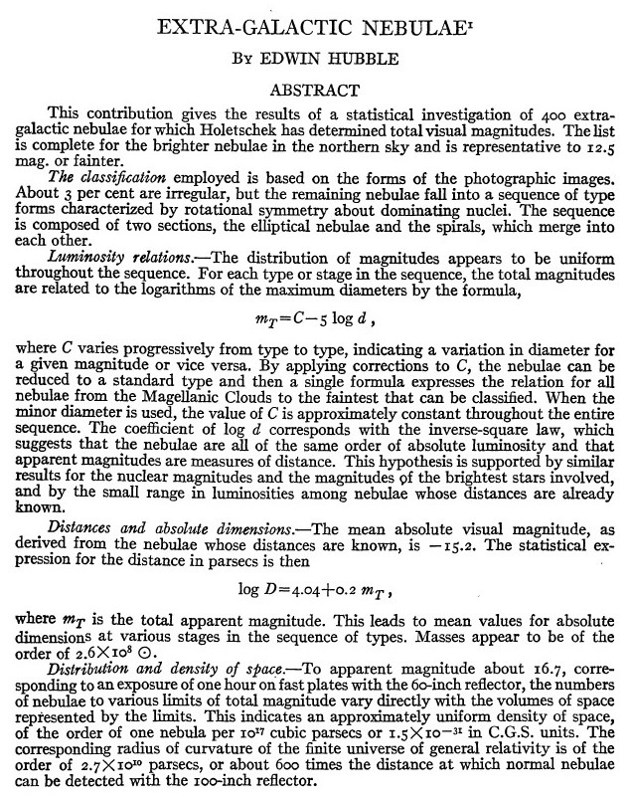
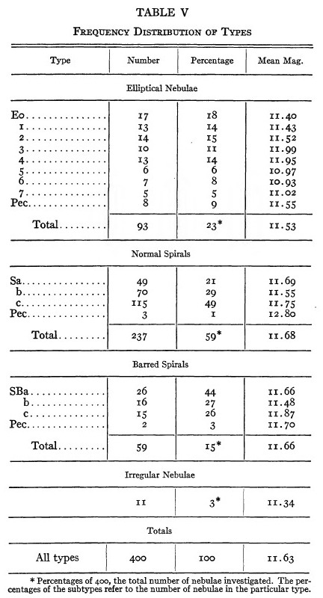
Astrophysical Journal, 64, 321-369 (1926)
http://adsbit.harvard.edu//full/1926ApJ....64..321H/0000321.000.html

Slide 12
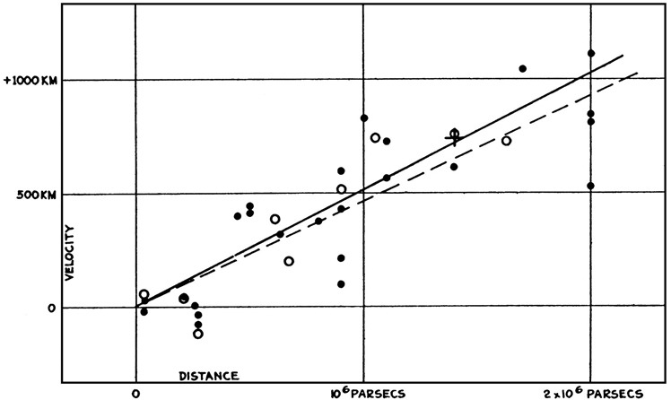
Červený posuv projevující se při vzdalování galaxií objevil Vesto Slipher již v roce 1912 na Lowellově hvězdárně ve Flagstaffu. Tento jev ale interpretoval jako expanzi vesmíru až teprve ve dvacátých letech na observatoři Mount Wilson pečlivý pozorovatel Edwin Hubble. Článek o tomto převratném objevu vyšel 17. ledna 1929 pod názvem A relation between distance and radial velocity among extra-galactic nebulae. Na šesti stránkách byly tři tabulky s daty, jeden graf a doprovodný text, v němž Hubble uváděl, že galaxie se od nás vzdalují tím rychleji, čím jsou dál.

Slide 13
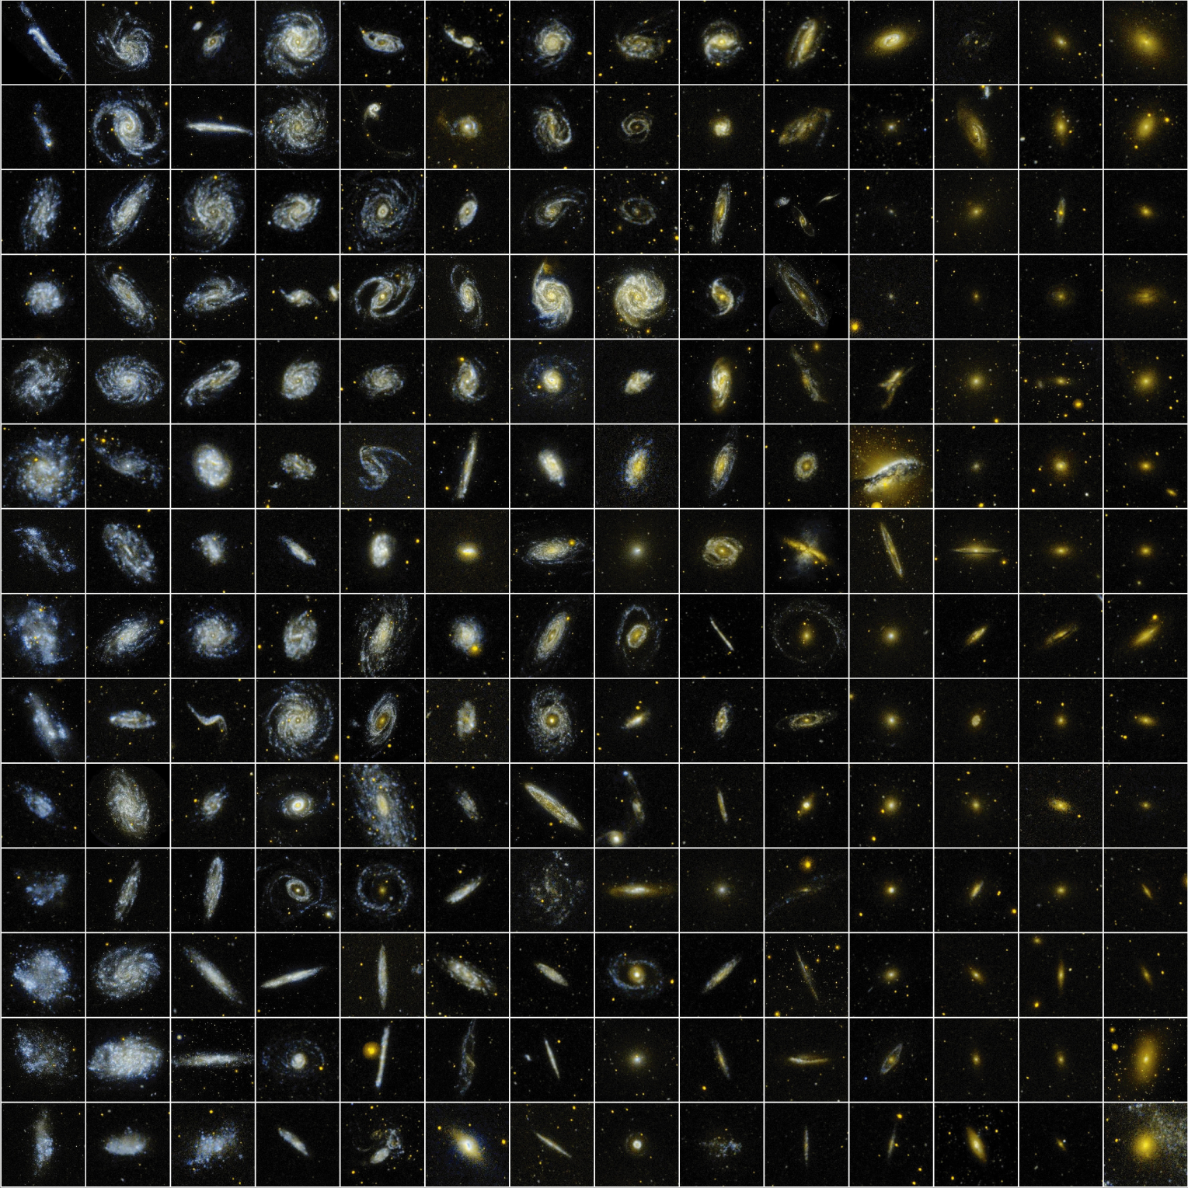
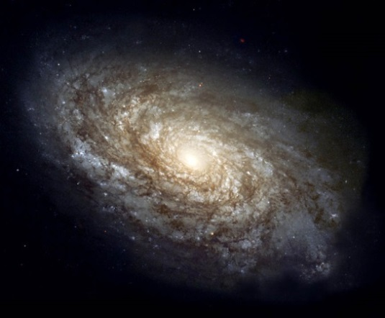
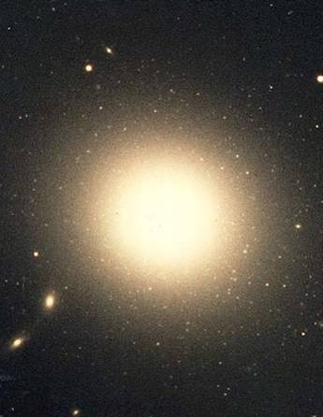
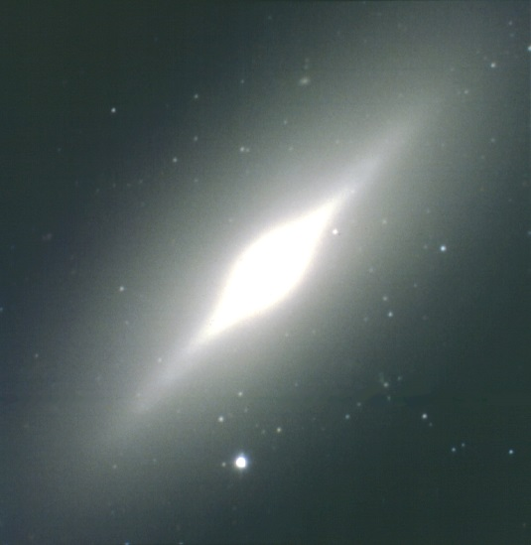
Spirální galaxie
Eliptická galaxie
Čočková galaxie

Slide 14
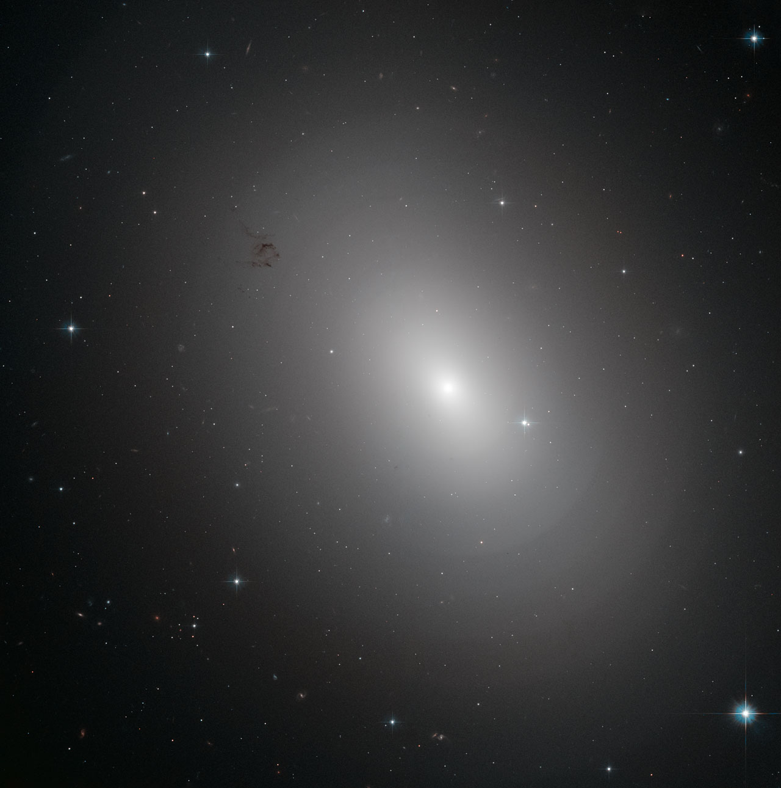
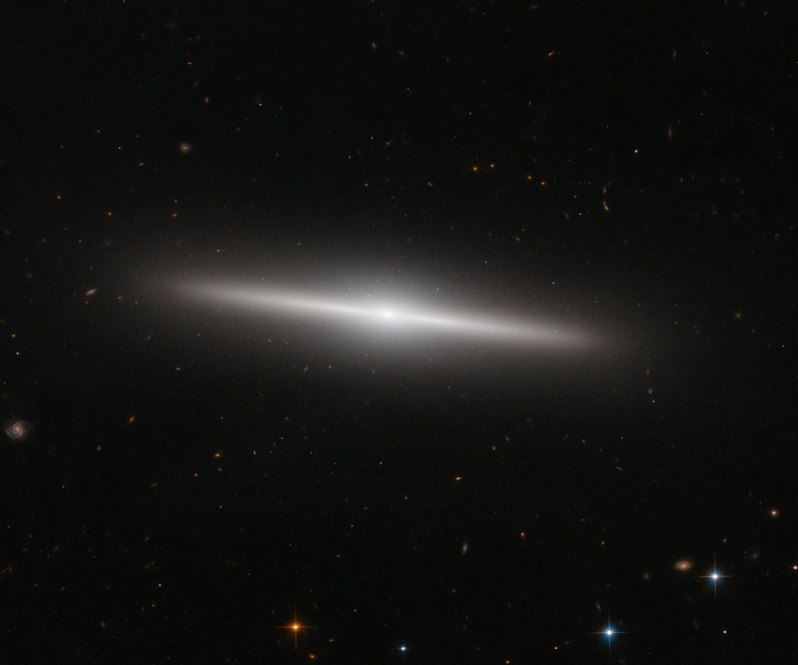
Eliptické galaxie
Vlevo je NGC 3923 ve vzdálenosti 90 milionů světelných roků v souhvězdí Hydry.
Vpravo je IC 335 klasifikovaná jako typ S0. Je ve vzdálenosti 60 milionů světelných roků a nachází se v souhvězdí Pece.

Slide 15
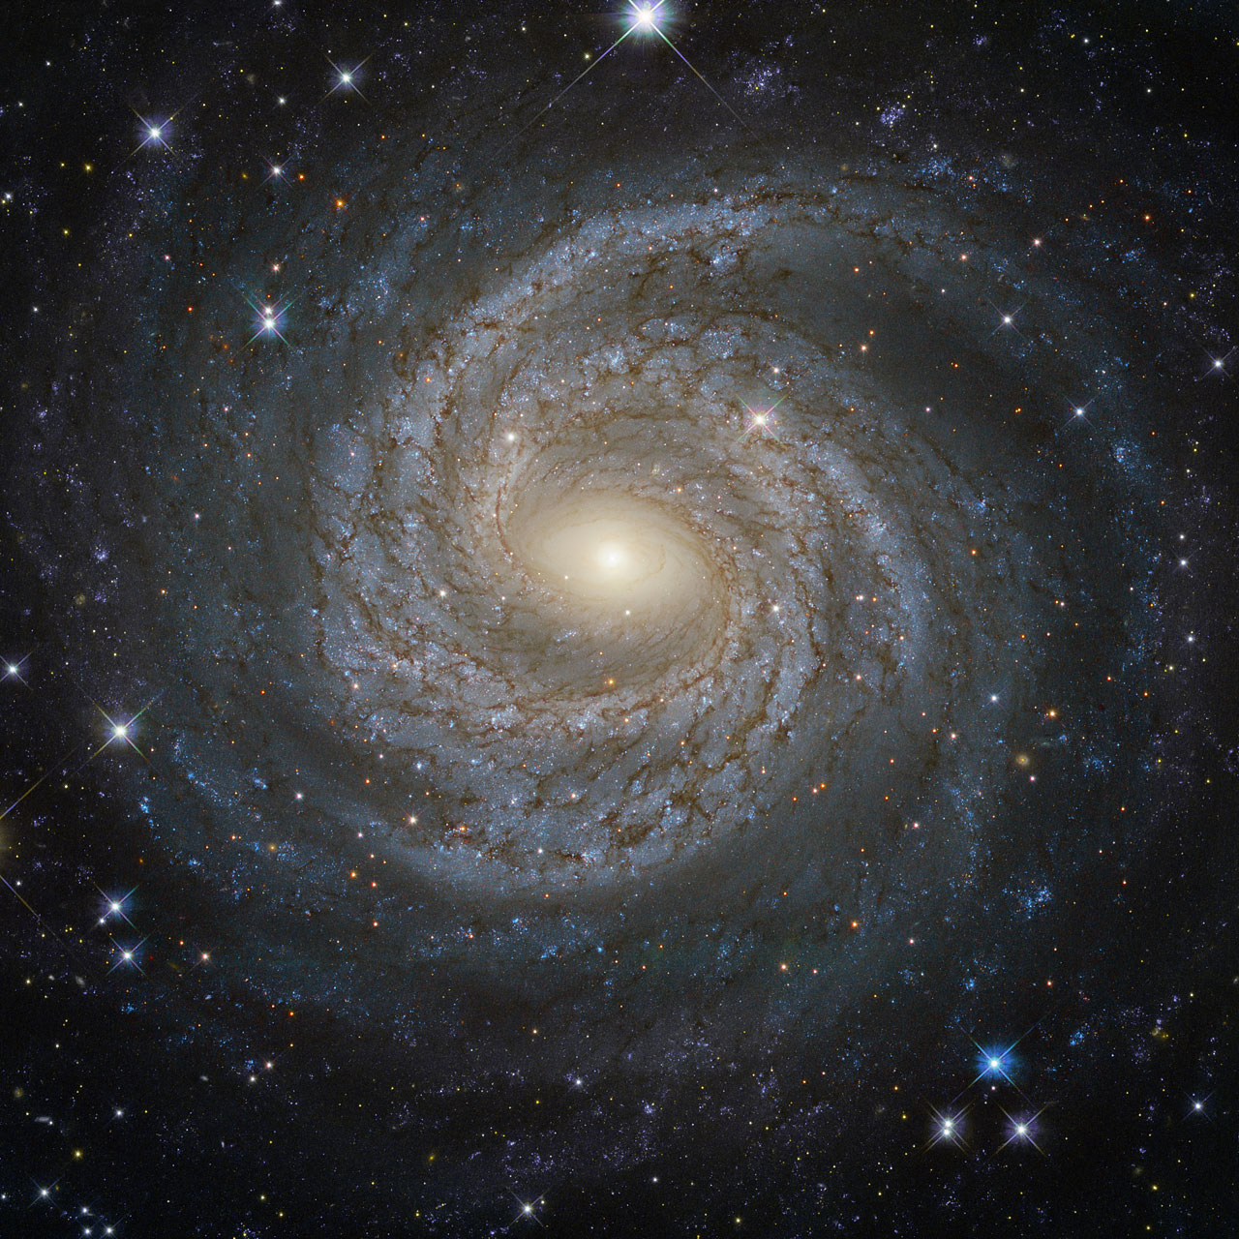
Spirální galaxie NGC 6814 ve vzdálenosti 75 milionů světelných roků v souhvězdí Orla. NGC 6814 je Seyfertovou galaxií s aktivním jádrem.

Slide 16
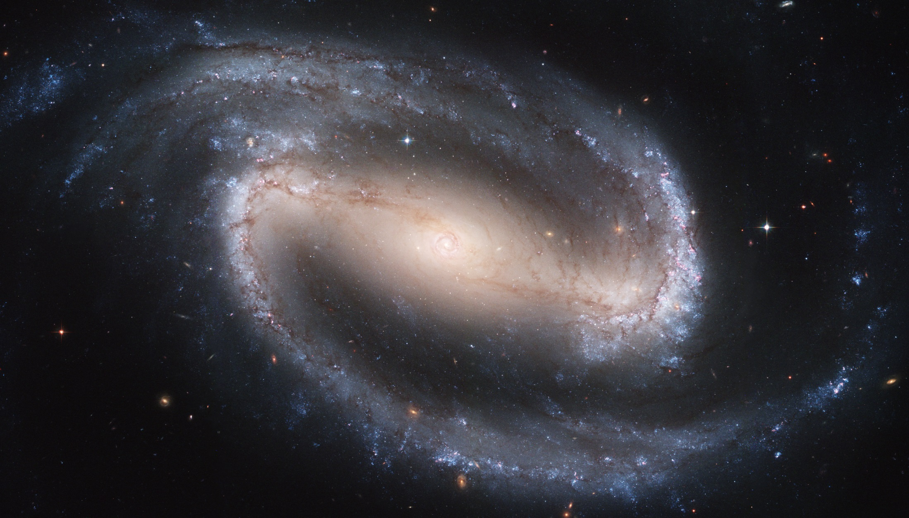
Spirální galaxie s příčkou NGC 1300 ve vzdálenosti 61 milionů světelných roků v souhvězdí Eridanus.

Slide 17
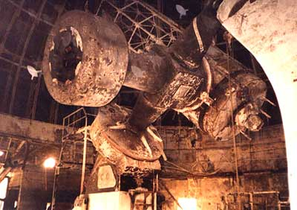
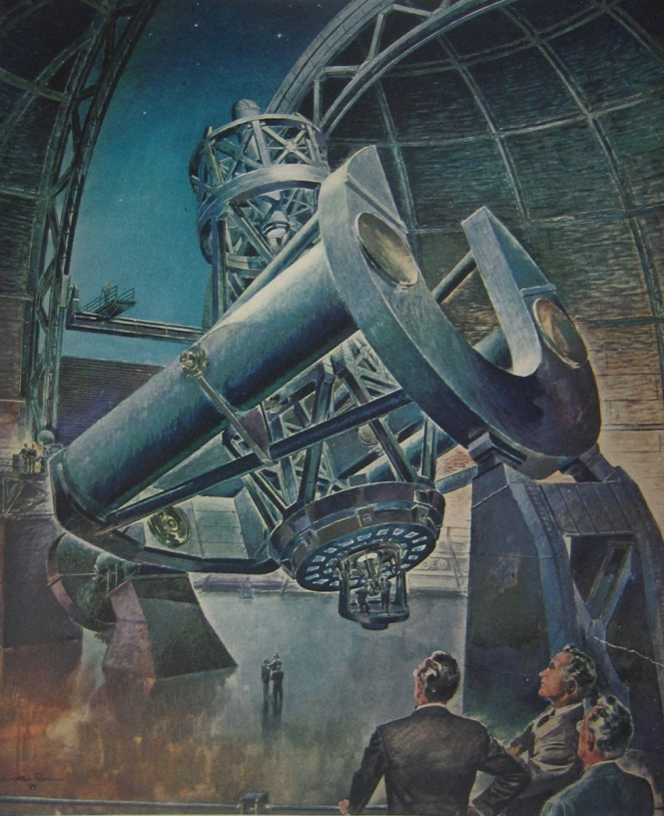
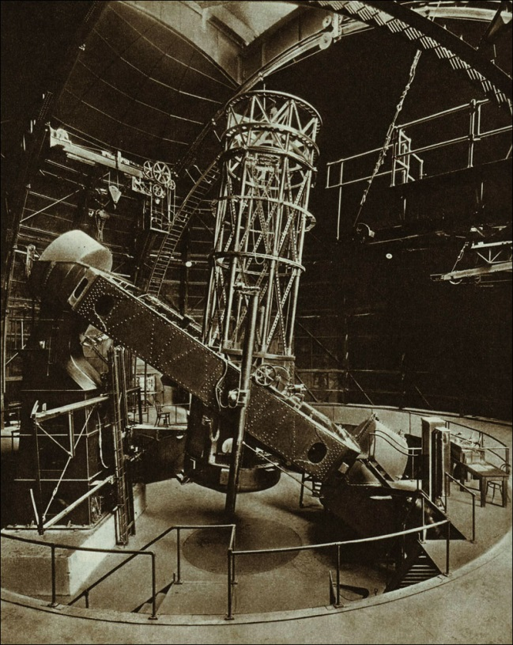
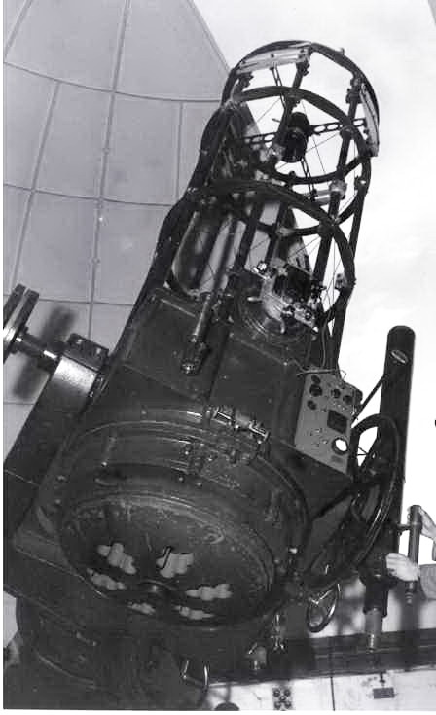
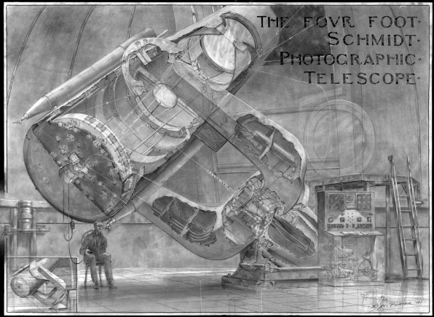
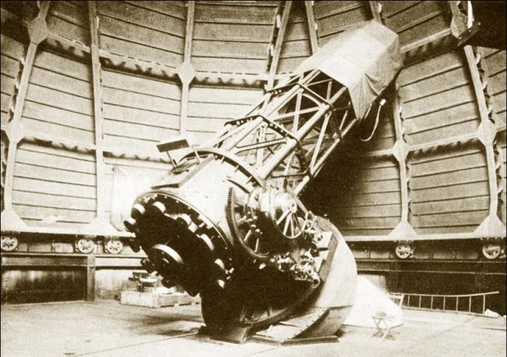
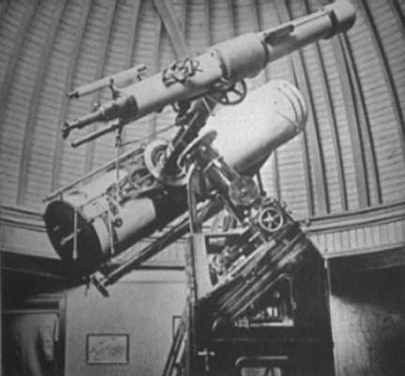
In order to minimize as far as possible the complications arising from differences in scale and resolution, several sources of illustrations were used as follows:
1. Mt. Palomar 200-inch reflector (P 200") and 48-inch telescope (P 48").
2. Mt. Wilson 100-inch and 60-inch reflectors (W 100"; W 60").
3. Mt. Stromlo 74-inch and 30-inch reflectors (S 74"; S 30").
4. Isaac Roberts 20-inch reflector (IR 20").

Slide 18
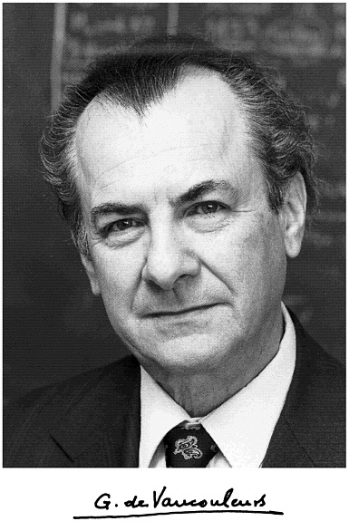
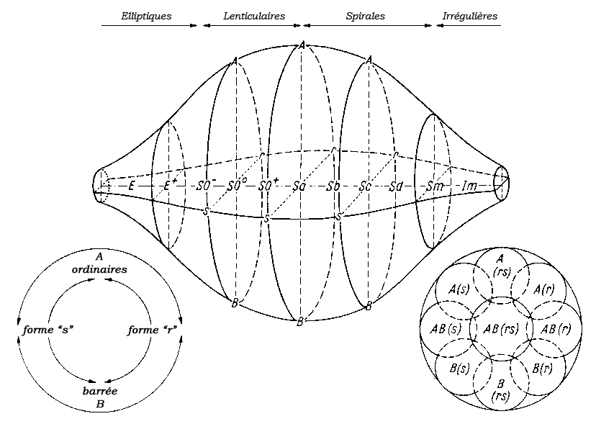
Francouzský astronom Gérard Henri de Vaucouleurs navrhl rozvedení Hubblovy klasifikace do třetího rozměru zavedením několika přechodových typů mezi typy již známými.
De Vaucouleursova rozšířená klasifikace z roku 1959. Galaxie jsou seřazeny od eliptických přes čočkovité, rozličné spirální typy a celá morfologie galaxií končí nepravidelnými soustavami (Irregular), které se snad mohly vyvinout postupně ze všech typů. https://ned.ipac.caltech.edu/level5/Dev/frames.html

Slide 19
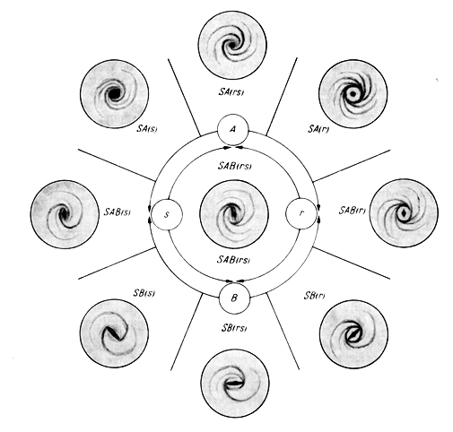
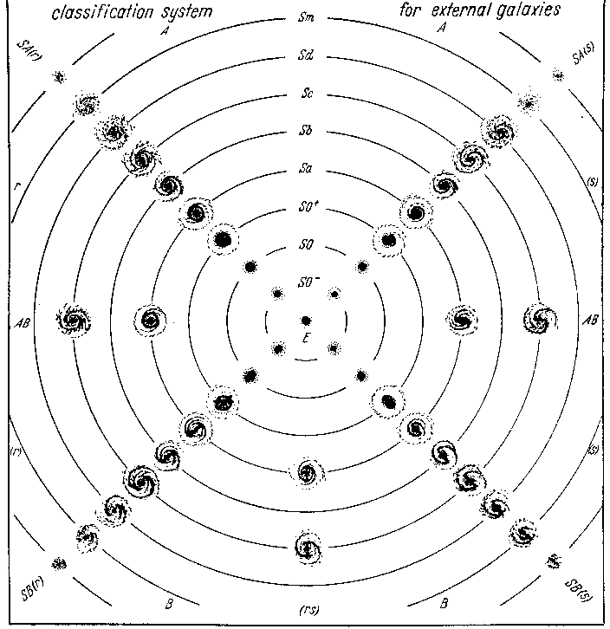
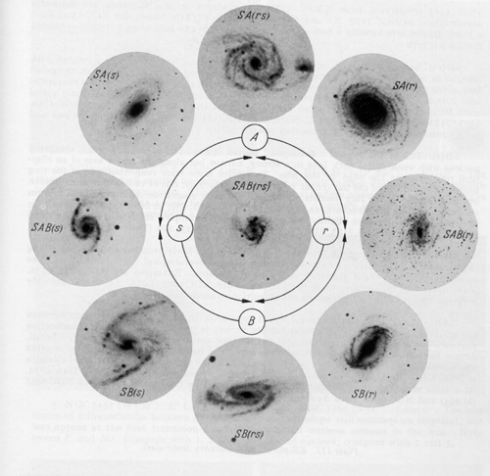
Revised classification: a plane projection of the classification volume. The ordinary spirals SA are in the upper half of the figure, the barred spirals SB in the lower half. The ring types (r) are to the left, the spiral types (s) to the right. Ellipticals and lenticulars are near the center, magellanic irregulars near the rim. The main stages of the classification sequence from E to Im through S0 -, S0, S0 +, Sa, Sb, Sc, Sd, Sm are illustrated, approximately on the same scale, along each of the four main morphological series SA (r), SA (s), SB (s), SB (r). A few mixed or ``intermediate'' types SAB and S (rs) are shown along the horizontal and vertical diameters respectively. https://ned.ipac.caltech.edu/level5/Dev/frames.html
Řez předchozím prostorovým grafem v úrovni typu Sb

Slide 20
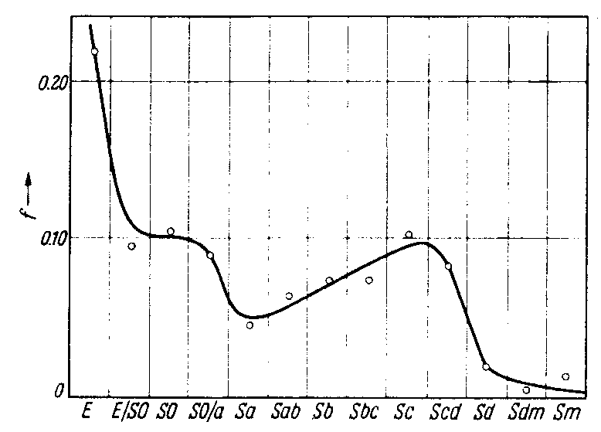
Frequency distribution of revised types in the Mount Stromlo survey. A plot of the frequencies gives a fairly smooth curve indicating maxima at Sc and E separated by a minimum at Sa. The low apparent frequency of the Sd, Sm stages is certainly due to a large extent to the low absolute luminosity and surface brightness of galaxies at these stages, but it is not yet possible to correct the apparent frequencies for such selection effects. On the other hand the high frequency of ellipticals cannot be due in general to an abnormally high absolute luminosity, so that it probably reflects the actual great abundance of this class. It should be emphasized that these provisional data based on a rather small sample of 200 objects are still subject to further revision; more definite and detailed results will eventually be forthcoming through the current reclassification of 1250 bright galaxies in the Shapley-Ames Catalogue. https://ned.ipac.caltech.edu/level5/Dev/frames.html

Slide 21
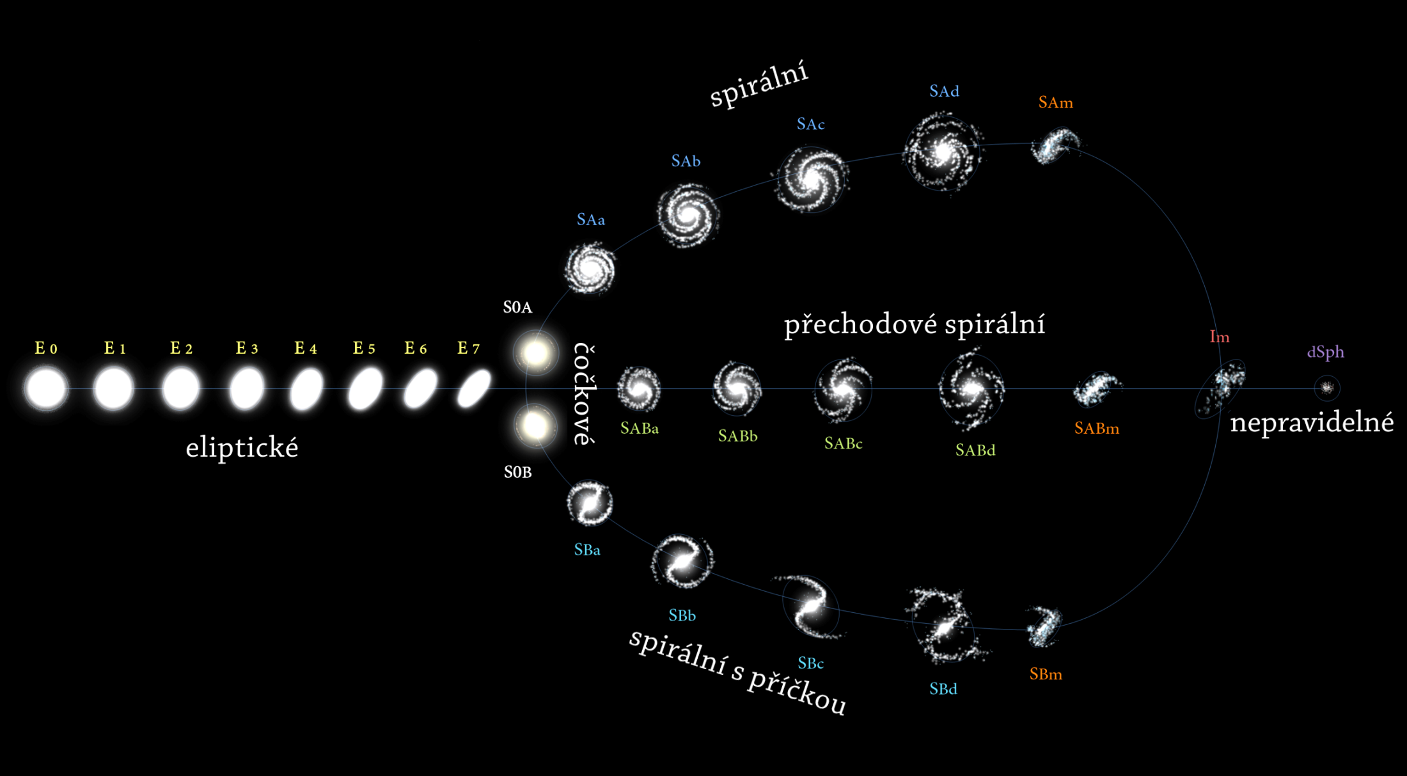
Hubblova klasifikace po de Vaucouleursově úpravě a zahrnutí přechodových typů

Slide 22
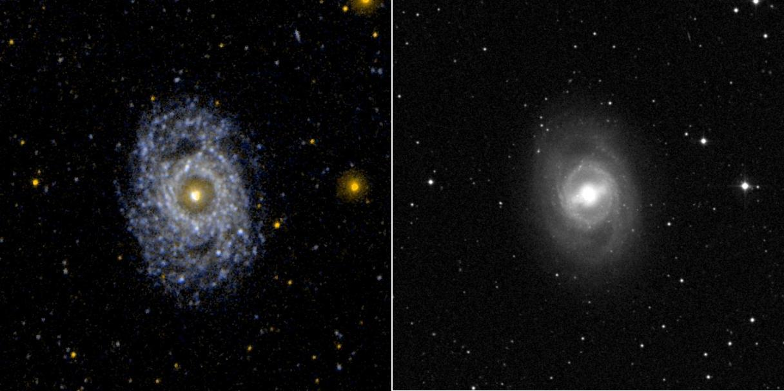
NGC 3351
Ultraviolet image (left) and visual image (right) of the face on barred and ringed spiral galaxy NGC 3351 (M95). The morphological appearance of a galaxy can change dramatically between visual and ultraviolet wavelengths. In the case of M95, the nucleus and bar dominate the visual image. In the ultraviolet, the bar is not even visible and the ring and spiral arms dominate.
https://www.jpl.nasa.gov/spaceimages/details.php?id=PIA07909

Slide 23
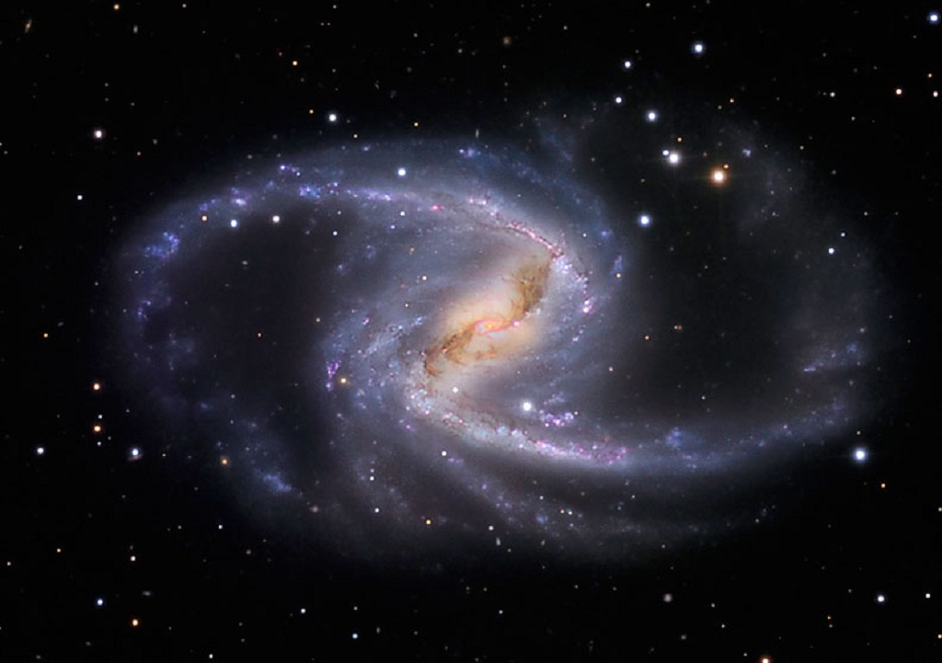
NGC 1365
NGC 1365, also known as the Great Barred Spiral Galaxy, is, as you would have guessed by its nickname, a huge barred spiral galaxy. It is over 200,000 light-years across, what makes it one of the largest galaxies known, and lies about 56 million light-years from Earth in the constellation of Fornax, while it is receding from us at approximately 1636 kilometers per second. It is a major member of the Fornax cluster which consists of 58 galaxies.
Many huge young star clusters trace out the main spiral arms and each contains hundreds or thousands of bright young stars that are less than ten million years old. NGC 1365 is too remote for single stars to be seen in this image and most of the tiny clumps visible in the picture are really star clusters. Over the whole galaxy, stars are forming at a rate of about three times the mass of our Sun per year.
While the bar of the galaxy consists mainly of older stars, many new stars are born in stellar nurseries of gas and dust in the inner spiral close to the nucleus. The bar also funnels gas and dust gravitationally into the very center of the galaxy, where a supermassive black hole is hidden among myriads of bright new stars.
This black hole has a mass 2 million times that of our Sun and is spinning almost as fast as Einstein’s theory of gravity will allow. Supermassive black holes are surrounded by pancake-like accretion disks, formed as their gravity pulls matter inward. The bright center of NGC 1365 is thought to be due to huge amounts of superhot gas ejected from such an accretion disk circling this central black hole.
The bar rotates clockwise with velocities in the nucleus of 2000 kilometers per second resulting in one rotation in 350 million years.
http://annesastronomynews.com/photo-gallery-ii/galaxies-clusters/ngc-1365-the-great-barred-spiral-by-martin-pugh/

Slide 24
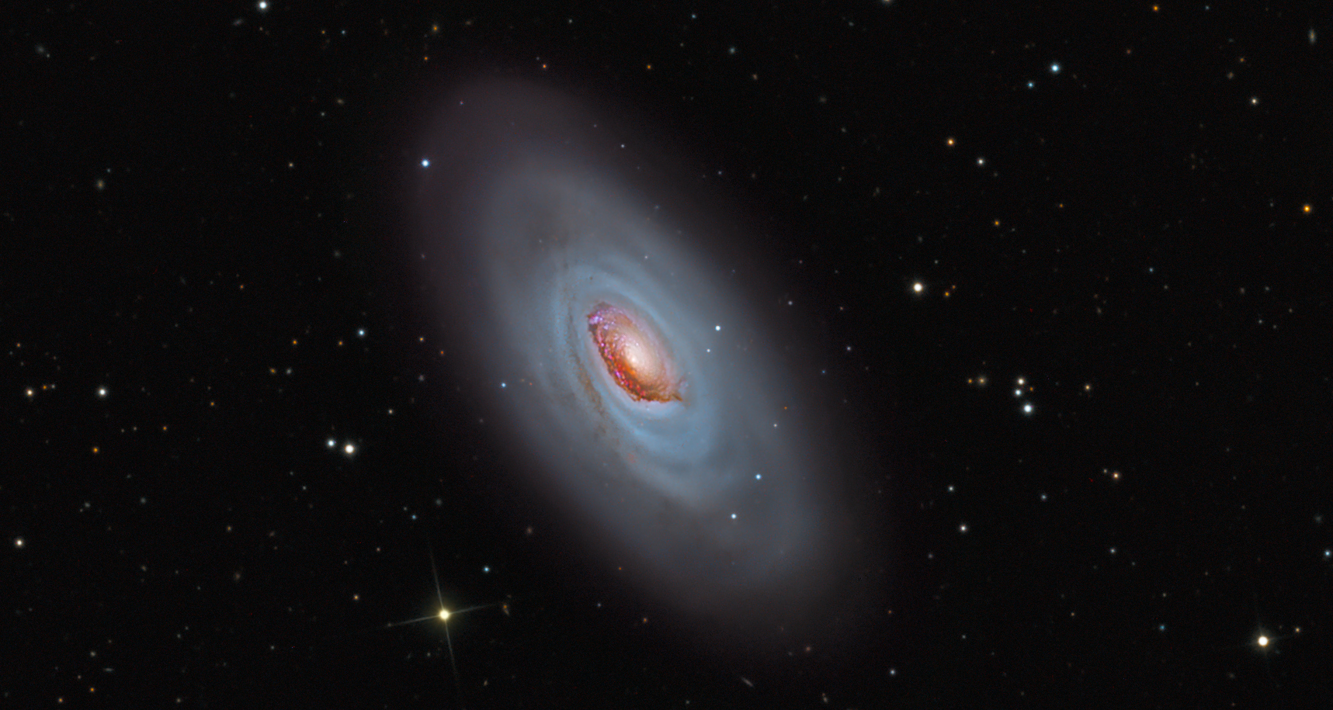
SPIRÁLNÍ Sa
M64 – Černé oko
M64 is about 17 million light-years distant in the otherwise well-groomed northern constellation Coma Berenices. In fact, the Black Eye Galaxy might also be an appropriate moniker in this colorful composition of narrow and wideband images. The enormous dust clouds obscuring the near-side of M64's central region are laced with the telltale reddish glow of hydrogen associated with star forming regions. But they are not this galaxy's only peculiar feature. Observations show that M64 is actually composed of two concentric, counter-rotating systems. While all the stars in M64 rotate in the same direction as the interstellar gas in the galaxy's central region, gas in the outer regions, extending to about 40,000 light-years, rotates in the opposite direction. The dusty eye and bizarre rotation is likely the result of a billion year old merger of two different galaxies.
https://apod.nasa.gov/apod/ap130404.html

Slide 25
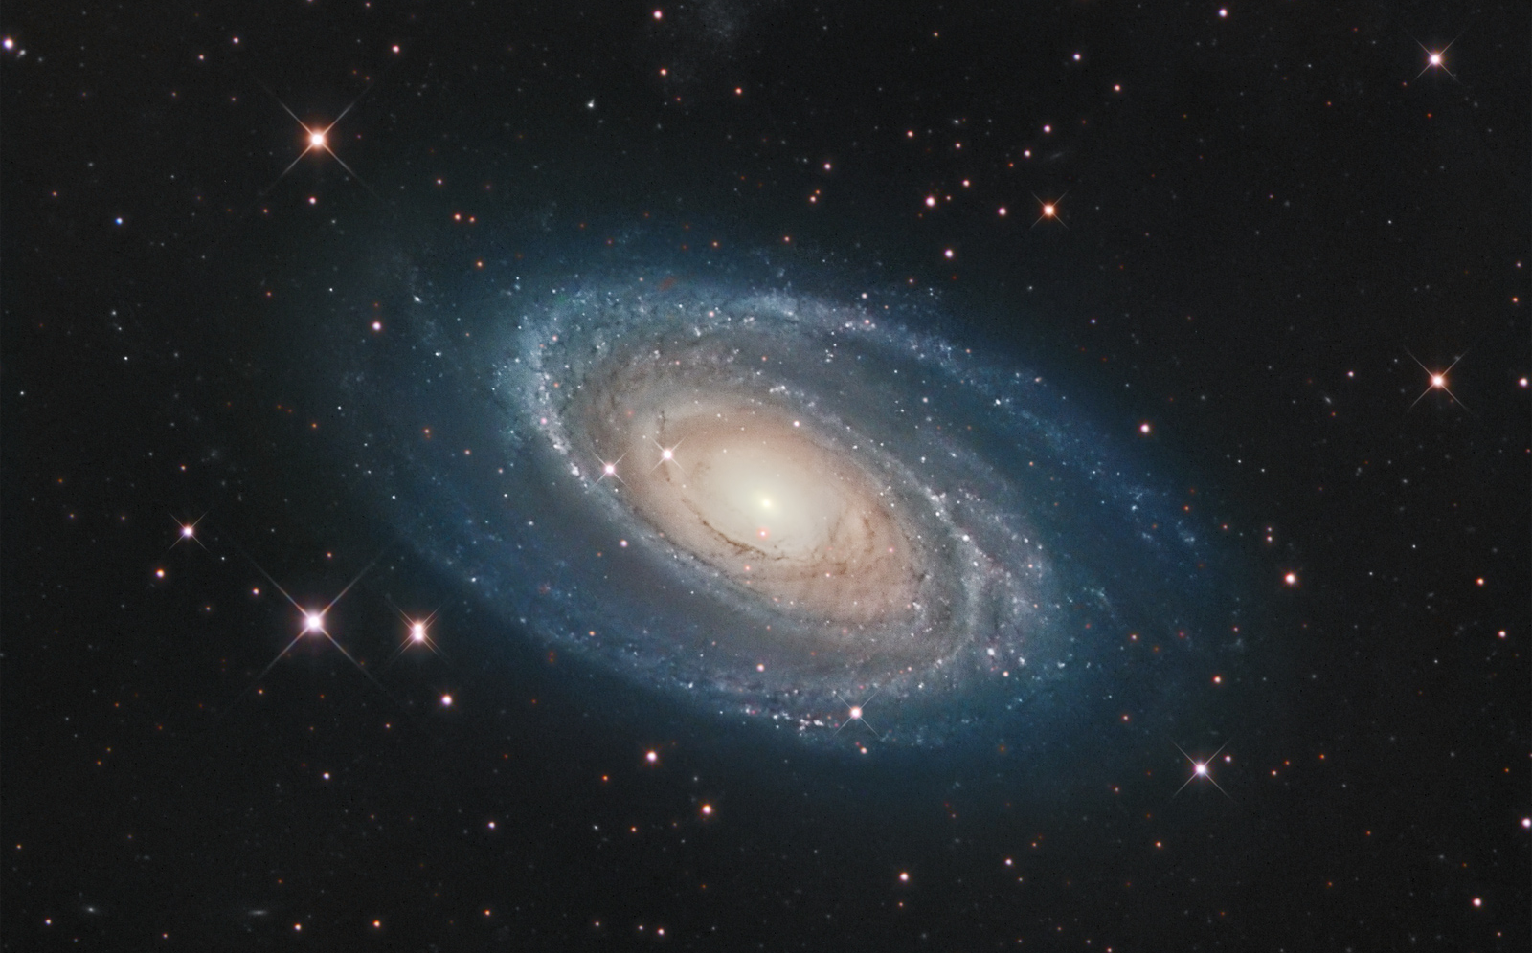
SPIRÁLNÍ Sb
M81
Messier 81 (také M81, Bodeho galaxie nebo NGC 3031) je spirální galaxie v souhvězdí Velké medvědice, která byla objevena Johannem Elertem Bodem 31. prosince 1774 společně s nedalekou galaxií M82. Obě galaxie jsou spolu s NGC 2403 nejjasnějšími členy skupiny galaxií M 81. M81 je od Země vzdálená 12 miliónů světelných roků a se svou magnitudou 6,9 a úhlovými rozměry 24,9'x11,5' patří mezi nejvýraznější galaxie.
https://apod.nasa.gov/apod/ap060707.html

Slide 26
SPIRÁLNÍ Sc
M83
M83 lies a mere twelve million light-years away, near the southeastern tip of the very long constellation Hydra. Prominent spiral arms traced by dark dust lanes and blue star clusters lend this galaxy its popular name, The Southern Pinwheel. But reddish star forming regions that dot the sweeping arms highlighted in this sparkling color composite also suggest another nickname, The Thousand-Ruby Galaxy. About 40,000 light-years across, M83 is a member of a group of galaxies that includes active galaxy Centaurus A. In fact, the core of M83 itself is bright at x-ray energies, showing a high concentration of neutron stars and black holes left from an intense burst of star formation. https://apod.nasa.gov/apod/ap151008.html

Slide 27
SPIRÁLNÍ Sd
NGC 7793
NGC 7793 (sometimes called Bond’s Galaxy) is an unbarred spiral galaxy of some 34,000 light-years across, located about 12.7 million light-years away from Earth in the small southern constellation Sculptor. It is receding form us at roughly 230 kilometers per second. It is one of the brightest galaxies within the Sculptor Group, an elongated, loosely bound group of 13 galaxies in the constellation of the same name, and the nearest group of galaxies to the Local Group of which our Milky Way is a member. The Sculptor Galaxy (NGC 253) and its companion galaxies forming a tightly-bound core of galaxies near the center. It is difficult to identify any particular spiral arm in these chaotic structures, although it is possible to guess at a general rotating pattern. The pink specks are regions were new star formation is taking place, and the many bright blue dots are young star clusters.
http://annesastronomynews.com/photo-gallery-ii/galaxies-clusters/ngc-7793/

Slide 28
SPIRÁLNÍ Sm
NGC 3109
NGC 3109 is classified as a Magellanic type irregular galaxy, but it may in fact be a small spiral galaxy. If it is a spiral galaxy, it would be the smallest in the Local Group. NGC 3109 has a mass of about 2.3×10⁹ times the mass of the Sun, of which 20% is in the form of neutral hydrogen. It is oriented edge-on from our point of view, and may contain a disk and a halo. The disk appears to be composed of stars of all ages, whereas the halo contains only very old and metal-poor stars. NGC 3109 does not appear to possess a galactic nucleus.
https://www.universetoday.com/27388/turning-the-tides-ngc-3109-by-ken-crawford/

Slide 29
SPIRÁLNÍ GALAXIE S ROZVINUTOU STRUKTUROU (GRAND DESIGN), MNOHORAMENNÉ (MULTI-ARM) A VLOČKOVITÉ (FLOCCULENT)
NGC 5194
M 51
NGC 5055
M 63
NGC 6946

Slide 30
NEPRAVIDELNÉ TRPASLIČÍ MAGELANOVSKÉ GALAXIE Im
https://web.archive.org/web/20060907134845/http://www.lowell.edu/users/dah/ubv.html
NGC 2366
DDO 50
Holmberg II
Wolf-Lundmark-Melotte Galaxy
DDO 221

Slide 31
SPIRÁLNÍ S PŘÍČKOU SBa
NGC 4650
NGC 4314

Slide 32
SPIRÁLNÍ S PŘÍČKOU SBb
NGC 1365

Slide 33
SPIRÁLNÍ S PŘÍČKOU SBc
M106
M106 je příkladem Seyfertovy galaxie. Neobvyklé rentgenové záření a radioteleskopem VLA pozorované rádiové vlny naznačují, že pravděpodobně část hmoty této galaxie padá do obří černé díry, která sídlí uprostřed galaxie. Hmotnost této černé díry se odhaduje na 36 milionů hmotností Slunce a její hmota je soustředěna v oblasti o poloměru 1/24 až 1/12 světelného roku, tedy 27 000 až 54 000 astronomických jednotek.Vzdálenost galaxie od Země se odhaduje na 23,8 milionů světelných roků a její celková hmotnost na přibližně 190 miliard hmotností Slunce. http://www.starshadows.com/gallery/display.cfm?imgID=444

Slide 34
SPIRÁLNÍ S PŘÍČKOU SBd
NGC 4631 VELRYBA
NGC 4631 (také známá jako Velryba nebo Caldwell 32) je spirální galaxie v souhvězdí Honicích psů vzdálená přibližně 19 milionů světelných roků. Na tuto galaxii nahlížíme směrem z boku, proto bývá tato galaxie často pozorována profesionálními astronomy, kteří chtějí porozumět plynu a hvězdám umístěným mimo rovinu galaktického disku. Na obloze se nachází v jihozápadní části souhvězdí, 5° severovýchodně od hvězdy Gama Comae Berenices (γ Com). https://apod.nasa.gov/apod/ap160603.html

Slide 35
LMC (Sm) – SMC (Im)

Slide 36
NEPRAVIDELNÉ GALAXIE
CENTAURUS A – NGC 5128
Only 11 million light-years away, Centaurus A is the closest active galaxy to planet Earth. Spanning over 60,000 light-years, the peculiar elliptical galaxy, also known as NGC 5128, is featured in this sharp color image. Centaurus A is apparently the result of a collision of two otherwise normal galaxies resulting in a fantastic jumble of star clusters and imposing dark dust lanes. Near the galaxy's center, left over cosmic debris is steadily being consumed by a central black hole with a billion times the mass of the Sun. https://apod.nasa.gov/apod/ap120404.html

Slide 37
NEPRAVIDELNÉ GALAXIE
M82
NGC 3034
DOUTNÍK
M82, as this irregular galaxy is also known, was stirred up by a recent pass near large spiral galaxy M81. This doesn't fully explain the source of the red-glowing outwardly expanding gas, however. Recent evidence indicates that this gas is being driven out by the combined emerging particle winds of many stars, together creating a galactic superwind.. The above photographic mosaic highlights a specific color of red light strongly emitted by ionized hydrogen gas, showing detailed filaments of this gas. The filaments extend for over 10,000 light years. The 12-million light-year distant Cigar Galaxy is the brightest galaxy in the sky in infrared light. https://apod.nasa.gov/apod/ap101219.html

Slide 38
NEPRAVIDELNÉ GALAXIE
NGC 3718
The most striking galaxy is NGC 3718, the warped spiral galaxy near picture center. NGC 3718's spiral arms look twisted and extended, mottled with young blue star clusters. Drawn out dust lanes obscure its yellowish central regions. A mere 150 thousand light-years to the right is another large spiral galaxy, NGC 3729. The two are likely interacting gravitationally, accounting for the peculiar appearance of NGC 3718. While this galaxy pair lies about 52 million light-years away, the remarkable Hickson Group 56 can also be seen clustered above NGC 3718, near the top of the frame. Hickson Group 56 consists of five interacting galaxies and lies over 400 million light-years away. https://apod.nasa.gov/apod/ap130803.html

Slide 39
NEPRAVIDELNÉ GALAXIE
The Antennae NGC 4038/39

Slide 40
A parsec-resolution simulation of the Antennae galaxies: Formation of star clusters during the merger
We present a hydrodynamical simulation of an Antennae-like galaxy merger at parsec resolution, including a multi-component model for stellar feedback and reaching numerical convergence in the global star formation rate for the first time. We analyse the properties of the dense stellar objects formed during the different stages of the interaction. Each galactic encounter triggers a starburst activity, but the varying physical conditions change the triggering mechanism of each starburst. During the first two pericenter passages, the starburst is spatially extended and forms many star clusters. However, the starburst associated to the third, final passage is more centrally concentrated: stars form almost exclusively in the galactic nucleus and no new star cluster is formed. The maximum mass of stars clusters in this merger is more than 30 times higher than those in a simulation of an isolated Milky Way-like galaxy. Antennae-like mergers are therefore a formation channel of young massive clusters possibly leading to globular clusters. Monitoring the evolution of a few clusters reveals the diversity of formation scenarios including the gathering and merger of gas clumps, the monolithic formation and the hierarchical formation in sub-structures inside a single cloud. Two stellar objects formed in the simulation yield the same properties as ultra-compact dwarf galaxies. They share the same formation scenario than the most massive clusters, but have a larger radius either since birth, or get it after a violent interaction with the galactic center. The diversity of environments across space and time in a galaxy merger can account for the diversity of the stellar objects formed, both in terms of mass and size.
https://arxiv.org/abs/1410.5754 http://www.astro.lu.se/~florent/movies.php

Slide 41
PRSTENCOVÉ GALAXIE
M104
NGC 4594
SOMBRERO
V roce 1921 nalezl francouzský astronom Camille Flammarion Messierovu osobní kopii Messierova seznamu, v které byla galaxie Sombrero připsána autorovou rukou. Flammarion ji identifikoval jako shodnou s objektem 4594 v New General Catalogue a dodatečně ji zařadil i do oficiálního Messierova seznamu pod číslem 104.

Slide 42
PRSTENCOVÉ GALAXIE
M104
NGC 4594
SOMBRERO
The Sombrero Galaxy (also known as Messier Object 104, M104 or NGC 4594) is a spiral galaxy in the constellation Virgo located 31,1 Mly) from Earth. The galaxy has a diameter of approximately 50 000 light-years, 30% the size of the Milky Way. It has a bright nucleus, an unusually large central bulge, and a prominent dust lane in its inclined disk. The dark dust lane and the bulge give this galaxy the appearance of a sombrero. Astronomers initially thought that the halo was small and light, indicative of a spiral galaxy, but the Spitzer space telescope found that the halo around the Sombrero Galaxy is larger and more massive than previously thought, indicative of a giant elliptical galaxy.
As noted above, this galaxy's most striking feature is the dust lane that crosses in front of the bulge of the galaxy. This dust lane is actually a symmetrical ring that encloses the bulge of the galaxy. Most of the cold atomic hydrogen gas and the dust lie within this ring. The ring might also contain most of the Sombrero Galaxy's cold molecular gas, although this is an inference based on observations with low resolution and weak detections. Additional observations are needed to confirm that the Sombrero galaxy's molecular gas is constrained to the ring. Based on infrared spectroscopy, the dust ring is the primary site of star formation within this galaxy. http://www.spitzer.caltech.edu/images/1421-ssc2005-11a1-Spitzer-and-Hubble-View-of-the-Sombrero-Galaxy

Slide 43
PRSTENCOVÉ GALAXIE
HOAGŮV OBJEKT
A nearly perfect ring of hot, blue stars pinwheels about the yellow nucleus of an unusual galaxy known as Hoag's Object. This image from NASA's Hubble Space Telescope captures a face-on view of the galaxy's ring of stars, revealing more detail than any existing photo of this object. The entire galaxy is about 120,000 light-years wide, which is slightly larger than our Milky Way Galaxy. The blue ring, which is dominated by clusters of young, massive stars, contrasts sharply with the yellow nucleus of mostly older stars. What appears to be a "gap" separating the two stellar populations may actually contain some star clusters that are almost too faint to see. Curiously, an object that bears an uncanny resemblance to Hoag's Object can be seen in the gap at the one o'clock position. The object is probably a background ring galaxy. http://hubblesite.org/newscenter/archive/releases/2002/21/

Slide 44
PRSTENCOVÉ GALAXIE
KOLO S LOUKOTĚMI
ESO 350-40
Observation data (J2000 epoch)
Constellation Sculptor
Right ascension 00^{h} 37^{m} 41.8^{s}
Declination -33° 42′ 59″
Distance 500 Mly
Discovered by Fritz Zwicky 1941
http://chandra.harvard.edu/photo/2006/cartwheel/

Slide 45
HST: Ring Galaxy AM 0644-741
vzdálenost: 300 milionů sv. roků
průměr: 150 000 sv. roků
souhvězdí: Mečoun
http://adsabs.harvard.edu/cgi-bin/nph-bib_query?bibcode=1997ApJ...474..686H

Slide 46
Arp 141
Arp 142
Arp 144
Arp 143
http://www.inaoep.mx/~ydm/rings/
Arp 145
Arp 291
I Zw 45
II Zw 28
NGC 2793
NGC 5410
VII Zw 465
NGC 985

Slide 47
SLAPOVÉ PŮSOBENÍ VE SKUPINĚ M81
ROZLOŽENÍ HVĚZD
ROZLOŽENÍ HI OBLASTÍ NA 21cm
Digital Sky Survey
rádiový obraz VLA

Slide 48
UGC 2885: typ Sc Spirální galaxie v Perseovi
RA = 3h 53.5m 2.5s DEC = +35° 35' 18'' vzdálenost ~ 96 Mpc průměr ~ 250 kpc
m = +13.5 úhlový rozměr = 5.5'
Hmotnost = 2 x 10¹² M¤ (Milky Way = 5 x 10¹¹ M¤ ) z = 5,800 km/sec

Slide 49
CANDELS galaxies reveal the Hubble Sequence throughout the Universe's history
This image shows "slices" of the Universe at different times throughout its history (present day, and at 4 and 11 billion years ago). Each slice goes further back in time, showing how galaxies of each type appear. The shape is that of the Hubble tuning fork diagram, which describes and separates galaxies according to their morphology into spiral (S), elliptical (E), and lenticular (S0) galaxies. On the left of this diagram are the ellipticals, with lenticulars in the middle, and the spirals branching out on the right side. The spirals on the bottom branch have bars cutting through their centres.
The galaxies in the "4 billion years" and "11 billion years" slides are all taken from CANDELS data. The present-day Universe shows big, fully formed and intricate galaxy shapes. As we go further back in time, they become smaller and less mature, as these galaxies are still in the process of forming. As far back as 11 billion years, it becomes difficult to distinguish between the different types visually, but this new study has found the sequence to be in place at these times.
https://www.spacetelescope.org/images/heic1315e/

Slide 50
STEPHANŮV KVINTET
NGC 7320C
NGC 7319
NGC 7318B
NGC 7318A
NGC 7317
NGC 7320
Skupina byla rozpoznána E. M. Stephanem v roce 1877. Stephanův kvintet byl popisován jako příklad kompaktní skupiny pěti galaxií. Jsou zde galaxie spirální, spirální s příčkou a eliptická, které byly všechny pozměněny vzájemným působením.
NGC 7319, 7318A, 7318B a 7317 jsou vzdáleny 300 milionů l.y. Největší NGC 7320 je nejspíše mnohem blíže – jen 40 milionů l.y., a pouze se promítá do stejného místa oblohy. Jsou zde ale i stopy mezigalaktické látky mezi NGC 7320 a zbylými čtyřmi galaxiemi. Možná červený posuv vůbec nesouvisí s kosmologickým pohybem celé galaxie. https://arxiv.org/abs/astro-ph/9802328

Slide 51
PROLÍNÁNÍ GALAXIÍ
April 24, 2008: Astronomy textbooks typically present galaxies as staid, solitary, and majestic island worlds of glittering stars.
But galaxies have a dynamical side. They have close encounters that sometimes end in grand mergers and overflowing sites of new star birth as the colliding galaxies morph into wondrous new shapes. Today, in celebration of the Hubble Space Telescope's 18th launch anniversary, 59 views of colliding galaxies constitute the largest collection of Hubble images ever released to the public. This new Hubble atlas dramatically illustrates how galaxy collisions produce a remarkable variety of intricate structures in never-before-seen detail. http://svs.gsfc.nasa.gov/30686

Slide 52
Vývoj růstu velké galaxie podobné naší Mléčné dráze z drobných galaxií simulovaný
na superpočítači ve Swiss National Supercomputing Center (CSCS).
http://www.hpc-ch.org/first-realistic-simulation-of-the-formation-of-the-milky-way-computed-at-cscs/

